Slide 1
Introduction to Computer Programming
Computer programming is the process of creating software solutions to important problems and ensuring those solutions are correct in every way possible
Many computer programs today are written in groups. Each person writes part of a program, and all parts are assembled into one large solution
Programming changes rapidly. Often new programming tools are created to make writing new computer code easier and more efficient

Slide 2
Computer Model
Main Memory (RAM)
Secondary Storage (HDD, USB Drive, etc.)
Input Device(s)
CPU
Output Device(s)
Arrows indicate the direction of information flow

Slide 3
Source Code vs. Machine Code
Source code is a collection of computer instructions written using English words and symbols that are designed to represent a computer program.
Machine code, by contrast, is a series of instructions made up of 0s and 1s where each instruction is a very basic instruction for the CPU to perform
Specific programs called compilers and interpreters are used to translate programs written in source code to machine code.
This translation is often difficult. 100+ lines of source code can easily be translated into thousands/millions of machine code instructions

Slide 4
Interpreters & Compilers
Interpreters
Source code is examined one line at a time. Each line is translated into machine code and executed immediately
Execution stops when no more lines are left to interpret or a bad instruction is encountered
Compilers
Source code is examined once for correctness and then the entire program is translated to machine code
The CPU executes the machine code until the program ends/an unforeseeable error is encountered

Slide 5
Interpreter Pros/Cons
Pros
Interpreters execute translated instructions immediately, so your program will begin running regardless of how complex it may be
You can modify programs mid-execution if necessary
Cons
Errors are only tracked when bad instructions are encountered (making it harder to check for errors.)
Instructions must be translated every time a program runs resulting in slower overall program execution

Slide 6
Compiler Pros/Cons
Pros
Compilers examine every instruction during compilation and can identify errors earlier than interpreters
Compiled code runs faster since instructions are only translated once
Cons
Compiling programs takes time with some very large programs requiring hours to compile
Any tiny change in the source code requires the entire program to be recompiled

Slide 7
What is Python?
Python is a language first created by Guido Van Rossum, a Dutch computer programmer.
Python was originally released in 1989, and has gone through several major revisions (version 3.6 as of 2018)
Python continues to evolve to provide simpler syntax, improve the runtime of Python programs, and develop additional and better programming resources.
Many professional programmers propose improvements to Python with Mr. Van Rossum having the final say as to whether a particular adjustment is accepted
Python is a language that has enjoyed international acceptance and continues to be a preferred language for both veteran and beginner programmers

Slide 8
A Quick Footnote about Python
Python currently supports two versions of the language: Python 2 and Python 3. Programs written in Python 2 cannot run in a Python 3 environment and vice versa
Python 2
Uses an older syntax of the language which include several “special case” features
Is still currently supported due to the vast amount of commercial software relying on it
Python 3
Uses a cleaner and more streamlined syntax thus eliminating most special cases
Is the main focus of the Python community
Our school uses Python 3 since it is best starting point for future Python programmers.

Slide 9
IDE
An Integrated Development Environment (IDE) is a program that is used to help create meaningful source code. Many IDEs include features such as:
A text editing panel to write/edit source code
Tools to make altering code simple and efficient
File management tools to help organize your programs
Code colorization to help identify keywords of the language, variable names, built-in functions, and highlight possible syntax errors
Debugging tools to add breakpoints in your program and examine variable states mid-execution
For this course, we use Wing 101 as a simple, easy-to-use IDE for beginner programmers
Wing 101 contains many features that make it a good IDE
Wing 101 removes many features that are not necessary for beginner programmers (but useful for professional programmers)

Slide 10
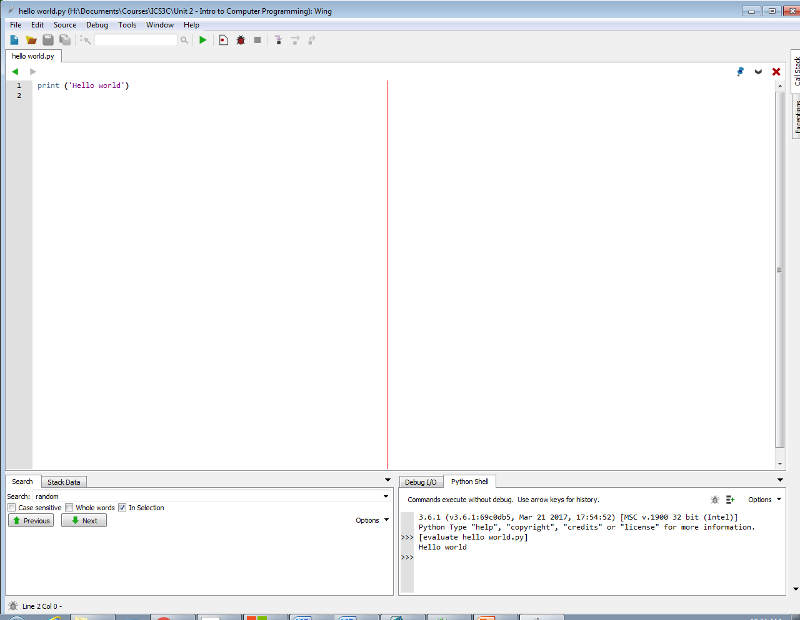
Wing 101 IDE
Execute code
File Management
Source code
Options in case you
need to restart the
Execution shell
Program input/ output /
Error messages

